Slide 1
Natural Language Processing
(NLP)

Slide 2
What is NLP?
NLP is a field in machine learning with the ability of a computer to understand, analyze, manipulate, and potentially generate human language.

Slide 3
Features

Slide 4

Optical Character Recognition(OCR)
Determine the corresponding text of a given image that represent a printed text.
hi.

Slide 5
Speech Recognition/Text-to-Speech
Speech recognition:
Given a sound clip of a person, determine the textual representation of the speech.
Text-to-speech:
Given a text, transform those units and produce a spoken representation.

Slide 6
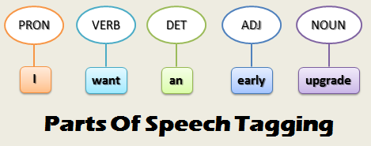
Part-of-Speech tagging(POS)
Given a sentence, determine the part of speech for each word.
Many words, especially common ones, can serve as multiple parts of speech.
Exp:
The book on the table “noun”.
To book a flight “verb”.

Slide 7
Stemming/Lemmatization
Stemming just removes or stems the last few characters of a word, often leading to incorrect meanings and spelling.
Exp:
If you lemmatize the word ‘Caring’, it would return ‘Care’. If you stem, it would return ‘Car’.
If you lemmatize the word ‘Stripes’ in verb context, it would return ‘Strip’, In noun context, it would return ‘Stripe’. If you just stem it, it would just return ‘Strip’.
You would get the same result such as walking, running .. to walk, run.
Lemmatization considers the context and converts the word to its meaningful base form, which is called lemma.
Sometimes, the same word can have multiple different Lemmas, so we should identify the POS tag for the word in that specific context.

Slide 8
Sentence breaking
Given a chunk of text, find the sentence boundaries.
Sentence boundaries are often marked by periods or other punctuation marks, but these same characters can serve other purposes.

Slide 9
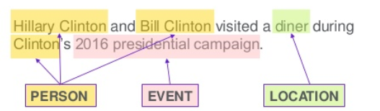
Named Entity Recognition(NER)
Given a stream of text, determine which items in the text map to proper names, such as people or places, and what the type of each, such name is person, location, organization.

Slide 10
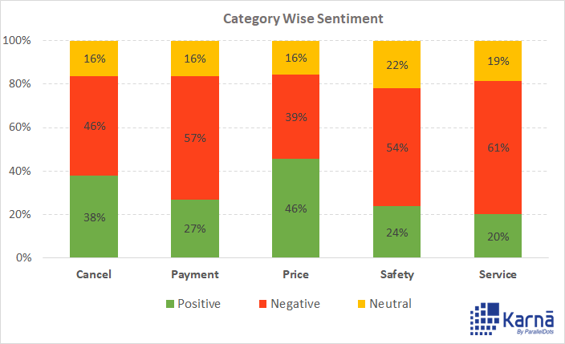
Sentiment analysis
It is an automated process capable of understanding the feelings of opinions that underlie a text by extracting subjective information, often using online reviews to determine “polarity” about specific objects. Expressions can be classified as positive, negative, or neutral.

Slide 11
Terminology extraction
Automatically extract relevant terms from a given corpus. Apart from saving time, we have the possibility to specify different search criteria, which allows to adapt the search query to a particular task.
This allows us to see all kinds of information we need about the term and to narrow the search and filter the results depending on what we are looking for.

Slide 12
Word sense disambiguation
Many words have more than one meaning, we have to select the meaning which makes the most sense in context.
We are typically given a list of words and associated word senses.

Slide 13
Relationship extraction
Given a chunk of text, identify the relationship among named entities.
It is a machine reading, acquiring structured knowledge from unstructured text.
Extract entities(people,location..).
Extract the relations between entities (located in..)

Slide 14
Semantic parsing/semantic role labeling
Semantic parsing:
Given a piece of text, produce a formal representation of its semantics.
Used for applications that needed to understand deeper about the meaning of words, like question answering.
Semantic role labelling:
Given a single sentence, identify and disambiguate semantic predicates, then identify and classify the frame elements.
Exp: “susan ate an apple”, susan is the doer of the eating, so she is an agent, the apple is the item that is eaten, so it is patient.

Slide 15
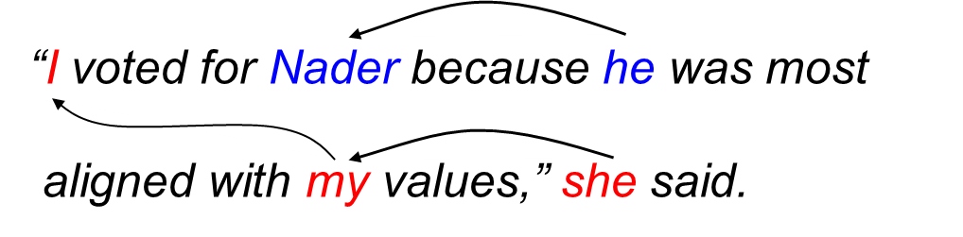
Coreference resolution
Given a sentence or larger chunk of text, determine which words refer to the same objects.
It is the task of finding all expressions that refer to the same entity in a text.

Slide 16
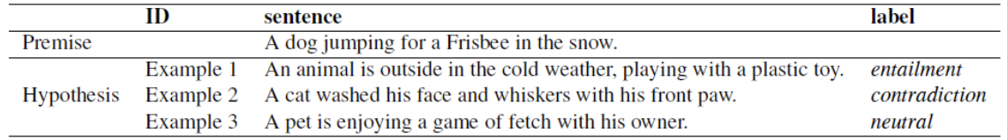
Recognizing textual entailment
It is a directional relation between text fragments.
The relation holds whenever the truth of one text fragment follows from another text.

Slide 17
Topic segmentation and recognition
Given a chunk of text, separate it into segments each of which is devoted to a topic, and identify the topic of the segment. (identify topic boundaries)

Slide 18
Automatic summarization
Produce a readable summary of a chunk of text. Often used to provide summaries of the text of a known type, such as research papers, articles in the financial section of a newspaper.
It is the task of condensing a piece of text to a shorter version, reducing the size of the initial text while at the same time preserving key informational elements and the meaning of content.

Slide 19
Natural Language Generation (NLG) / Natural Language Understanding(NLU)
NLG:
Convert information from computer databases or semantic intents into readable human language.
NLU:
Convert chunks of text into more formal representations that are easier for computer programs to manipulate.
Involves the identification of the intended semantics which can be derived from a natural language expression.

Slide 20
Dialogue management
Computer systems intended to converse with a human.
First, Natural and Spoken Language Understanding (NLU or SLU) aiming at extracting meanings from text or spoken inputs.
Second, Natural Language Generation (NLG) involves the transcription of a sequence of meanings into a written text.
Finally, Dialogue Processing (DP) that analyses and models the interaction from the system’s side and feeds NLG systems according to extracted meanings from user’s inputs by NLU.

Slide 21
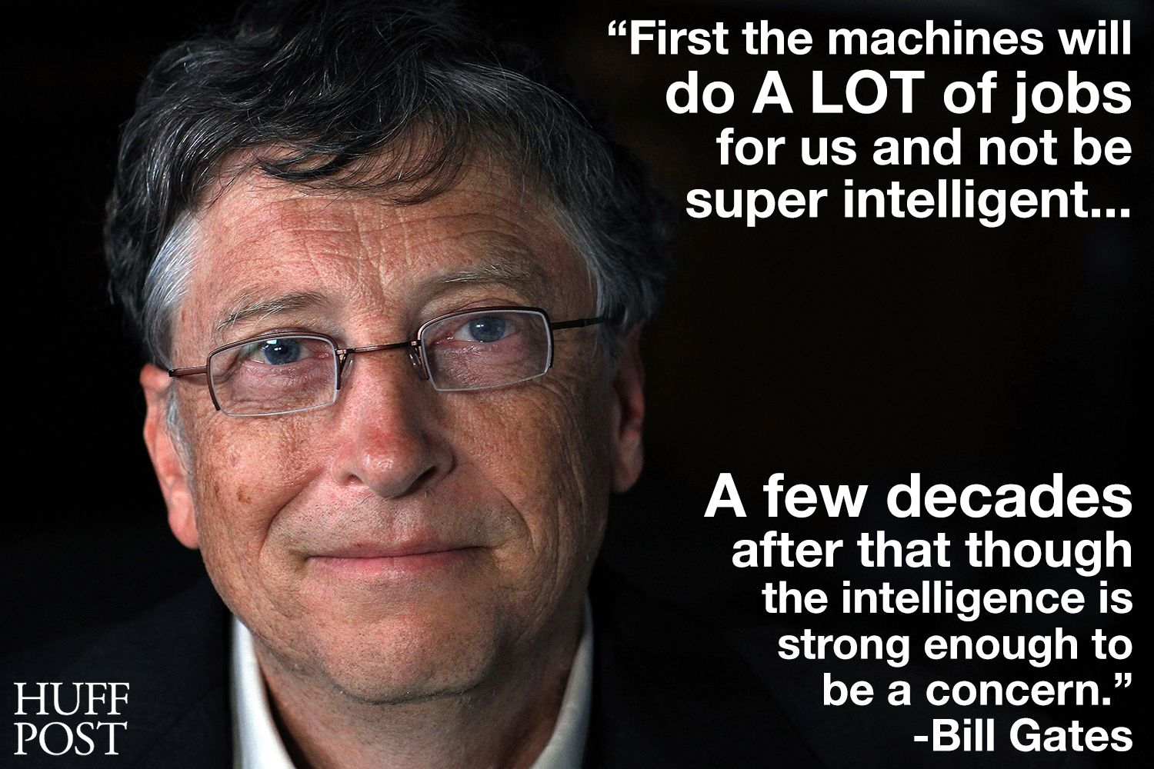

Slide 22

Thanks!

